Slide 1
Trends in U.S. Electric Power Markets and Renewable Integration
18 December 2018
Erik Ela, PhD
Principal Technical Leader
eela@epri.com
21st Century Power Partnership Webinar

Slide 2

Agenda
North American ISO & RTO introduction
  Current products and services
How does variable energy resources (wind and solar) impact market outcomes and changing design?
How are the markets evolving going forward due to changing resource mix?
  Specific California Examples

Slide 3
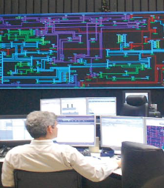
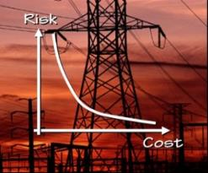

EPRI Grid Operations & Planning R&D Area at a Glance
Grid Operations
Grid Planning
Operator Visualization
Synchrophasor Applications
Operating Limit Assessment
Reactive Power & Voltage Management & Control
System Restoration Support
Modeling & Validation
System Protection
Risk-Based Planning
Contingency Screening
Special Planning Studies (GMD, TOV, etc.)
Market Operations
Bulk Renewables Integration
Market Design
Market Software Implementation
Price Formation
Energy, Ancillary Services, FTRs, Capacity
Modeling & Protection
Flexibility Planning
Operator Tools for Variability & Uncertainty
Voltage & Frequency
DER Impacts on Bulk System
Reliability Analysis Methods/Tools
Economic Analysis Methods/Tools
Decision Support Methods/Tools
Model Development & Validation
Operator/Planner Reference Guides
Common approach to all programs

Slide 4
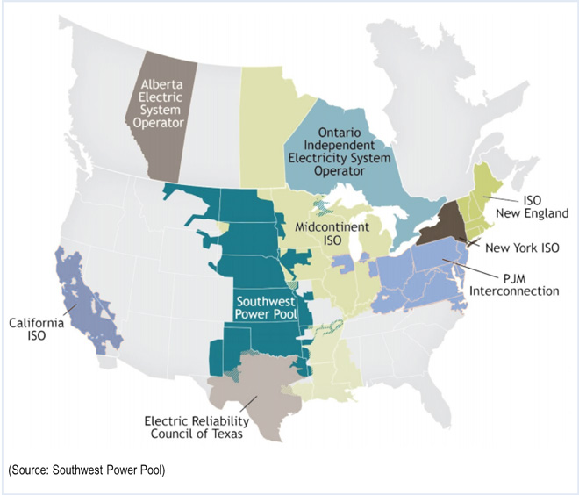
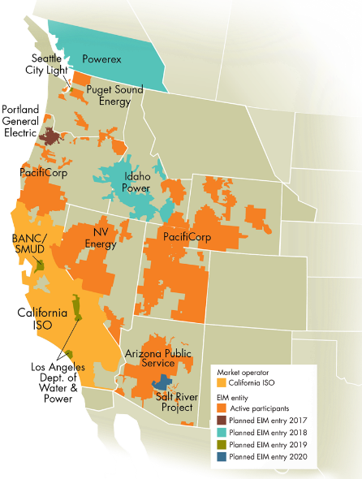
Organized Electricity Markets in North America
ISO/RTO Data 2015
Serve 118 Million customers (2/3)
Installed Capacity = GW (70%)
Electricity Consumption 80%
Nine Independent System Operators (ISOs) and Regional Transmission Organizations (RTOs) serve 66% of consumers in the U.S. and more than 50% of Canada’s population. See the ISO/RTO Council website: www.isorto.org.
Energy Imbalance Market
*Source: http://www.eia.doe.gov/cneaf/electricity/epa/epaxlfilees1.pdf

Slide 5
Electricity Market Characteristics
 | ISO-NE | NYISO | PJM | MISO | SPP | ERCOT | CAISO
Peak Load (MW) | 28,000 | 34,000 | 165,000 | 127,000 | 46,000 | 69,000 | 47,000
Total Generation Capacity (MW) | 31,000 | 39,000 | 184,000 | 180,000 | 83,000 | 77,000 | 60,000
Generating Units | 350 | 400 | 1,400 | 1,400 | 750 | 550 | 760
Annual Energy (TWH) | 120-135 | 160-165 | 780-840 | 600-680 | 225-240 | 340-350 | 230-260
Transmission (Miles) | 8,000 | 11,000 | 72,000 | 66,000 | 61,000 | 46,000 | 26,000
*2014 Approximate Data

Slide 6

Current Market Products
Energy Market
  Day-Ahead Energy Market
  Real-Time Energy Market
  Virtual Trading
Ancillary Services Market
  Reserve Market (market-based)
  Regulation market (market-based)
  Voltage support (cost-based)
  Blackstart service (cost-based)
Financial Transmission Rights Markets
  Including Auction Revenue Rights
Capacity Markets
  Flexible Capacity

Slide 7
Electricity Market Timelines
Long-term power purchase agreements
Forward Capacity Markets
Seasonal or Annual Capacity Markets
Day-ahead energy markets
Day-ahead ancillary markets
Real-time (balancing) energy market
Real-time (balancing) ancillary market
Financial Transmission Rights Auction
Price corrections & settlement procedures
20 years
3 years
Months
Hour-ahead
Real-time
Day-ahead
Months after

Slide 8
How much money flows through these markets?
2014 data
 | ISO-NE | NYISO | PJM | MISO | SPP | ERCOT | CAISO
Total Market Volume ($B) | 10.6 | 14.7 | 50.0 | 32.5 | 10.6 | 15.0 | 12.1
All-in Price ($/MWh) | 78 | 75 | 65 | 40 | 34 | 41 | 52
Energy ($B) | 9.0 | 11.2 | 41.4 | 31.9 | 7.4 | 13.8 | 11.7
Ancillary Services Markets ($M) | 236 | 150 | 1,881 | 180 | 116 | 513.4 | 69
Uplift ($M) | 174 | 147 | 965 | 351 | 77 | N/A | 95
FTR ($M) | 34 | 183 | 733 | 1,155 | 373 | 375 | 104
Capacity Market ($M) | 1,060 | 3,220 | 7,030 | 145 | N/A | N/A | N/A
Potomac Economics, ERCOT State of the Market Report, 2014

Slide 9

Impact of VER on Electricity Markets
Low variable cost of wind and solar can reduce the average energy prices
The variability of VER can also cause increased variability in energy prices
It can cause greater disparity between prices of forward markets (DA) and real-time markets due to the uncertainty of VER output
The variability and uncertainty can cause uncertain power flows affecting financial transmission rights markets
VER can impact the amount of operating reserve required or supply of operating reserve therefore impacting prices of ancillary services
VER can cause greater need for flexible resources, which may or may not be incentivized to provide that flexibility in the energy market

Slide 10



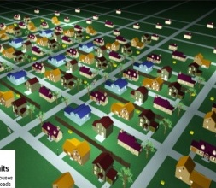
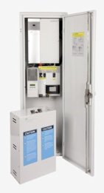

Market Evolution
Central Station
Variable Generation
Demand Response
Energy Storage
Electric Power Research Institute, Capacity and Energy in the Integrated Grid, EPRI, Palo Alto, CA: 2015 Product 3002006692, Available: https://www.epri.com/#/pages/product/000000003002006692/

Slide 11
Electricity Market Design Initiatives
 | Mutual or Similar Initiatives | Unique Initiatives
Energy Markets | Improved coordinated transaction scheduling (NYISO, ISO-NE, PJM, MISO, SPP, and CAISO) Combined Cycle Modeling Improvements (PJM, MISO, SPP) Virtual spread product (e.g., up-to-congestion, or point-to-point) (NYISO, MISO, CAISO) Pricing of fast start resources (e.g., ELMP, fast start pricing, allowance of GTs to set RTD price) (ISO-NE, NYISO, MISO, CAISO) | Do-not-exceed limits for wind generation (ISO-NE) Flow control resources as market participants (MISO) 15-minute three settlement market (CAISO) Integrated day-ahead market (CAISO)
Ancillary Service Markets | Regulation pay-for performance improvements (PJM, SPP, CAISO) Ramp products (MISO, SPP, CAISO) Primary frequency response (MISO, ERCOT, CAISO) | Synchronous Inertia service (ERCOT) Gas system limitations on reserve provision (NYISO) Reserve product for voltage needs (MISO)
Financial Transmission Rights | FTR funding issue resolution and shortfall allocation methods (PJM, MISO, CAISO) Long-term FTR (ISO-NE, MISO, CAISO, others have as initiatives that are not on the immediate term) Incorporating transmission outages into FTR auctions (SPP, CAISO) | Third-party FTR clearing (ISO-NE) Rights for PAR-controlled lines (NYISO)
Capacity Markets | Sloped demand curves (ISO-NE, MISO) Locational capacity market improvements (ISO-NE, NYISO, MISO) Performance incentives (ISO-NE, NYISO, PJM) Locational price hedging (NYISO, PJM, MISO) | Flexible capacity procurement (CAISO) Changing from annual to seasonal markets (MISO)
Key design changes primarily due to changing resource mix
Electric Power Research Institute, Wholesale Electricity Market Design Initiatives in the United States: Survey and Research Needs, EPRI, Palo Alto, CA: 2016. Product 3002009273, Available: https://www.epri.com/#/pages/product/000000003002009273/

Slide 12
Market Expansion and Coordination
Western Energy Imbalance Market
Operated by CAISO
Six utilities participating, five more planned

Slide 13


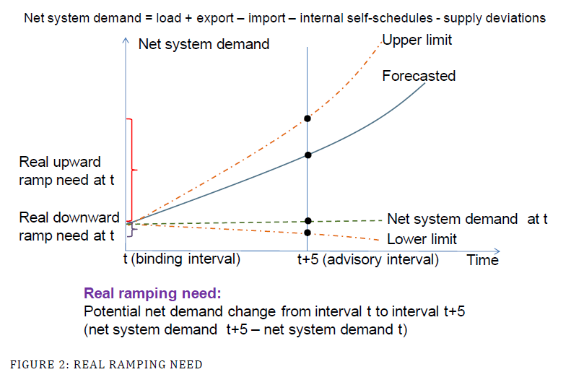
Flexible ramping needs (Short- and Long-term
Short-term ramping products
Requirements based on short-term variability and uncertainty to operate with more ramping and avoid infeasibilities and imbalances in real-time
  Confidence
  intervals inform
  requirements
  Low-priced demand
  curves
MISO: May 1, 2016
CAISO: Nov. 1, 2016
  Flex ramp constraint live since 2012
Flexible capacity (long-term)
Ensure sufficient flexible resources installed in planning time frame
Must offer/bid flexibility if flexible capacity resource
CAISO: Since 2014
FRACMOO

Slide 14
Greatest R&D Challenges
More resources may be needed for fewer periods, but still needed
  Do they have the long-term incentives to avoid retirement?
  Will demand response and a smarter grid reduce the need for resources?
Are there proper incentives to get the increased amount of flexibility on the system that is needed to maintain system reliability
  Short-term: Attract available flexibility to provide this flexibility
  Long-term: Attract new or existing facilities to build or modify with flexibility attributes
How are “essential reliability services” being incentivized
  Services that used to be inherent that may be declining

Slide 15
Greatest R&D Challenges (2)
What is the right price?
  Non-Convexities, uplift vs. price, out-of-market vs. in-the-market, alignment of pricing and reliability
How can the market function properly with new policies that favor technologies for reasons other than cost or reliability?
  Environmental, job preservation, fuel diversity, local tax
Changing resource mixes have new characteristics: Technology agnostic vs. realism?
  Energy storage technologies, demand response, renewables, distributed energy, natural gas
Simplicity vs. complexity
  Do stochastics, reactive power, multi-state configurations need to be part of the market clearing?

